Slide 1

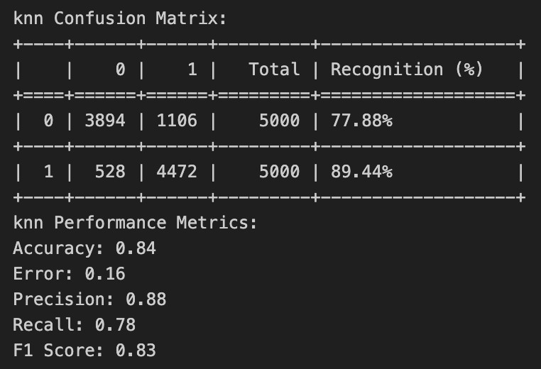
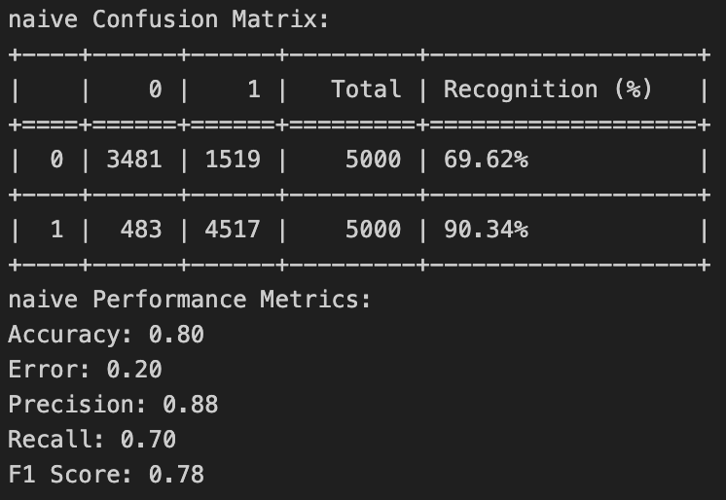
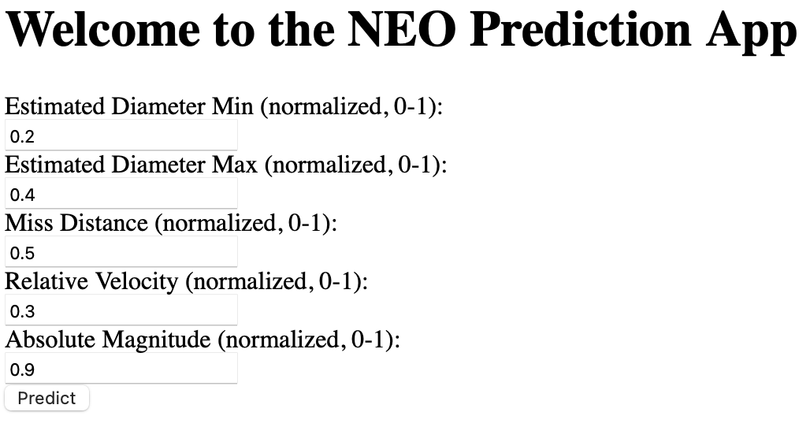
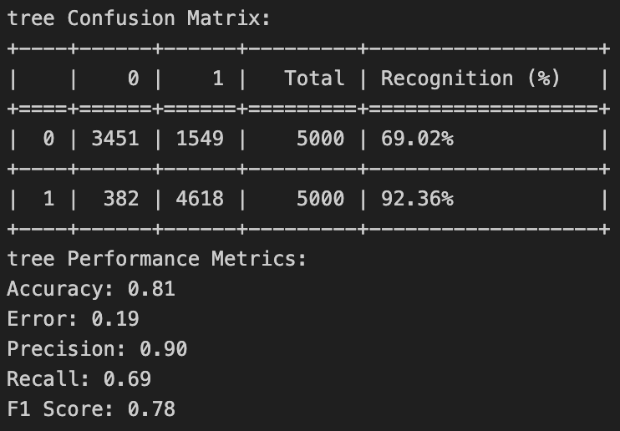
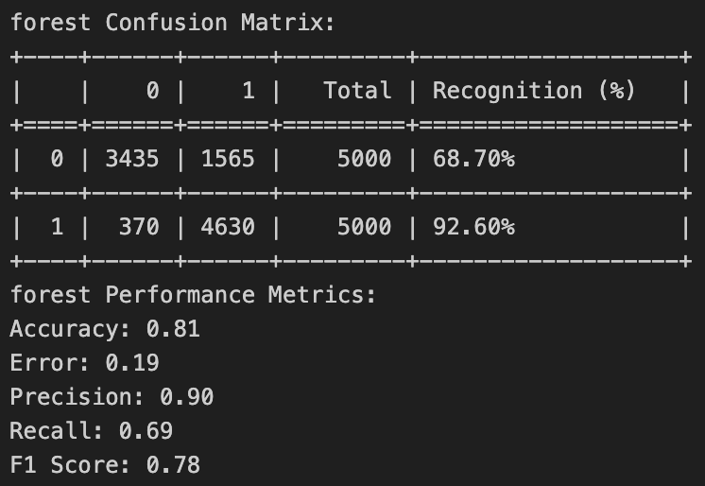
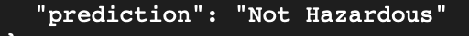
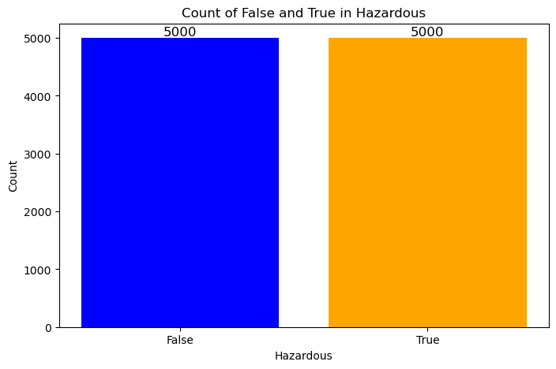
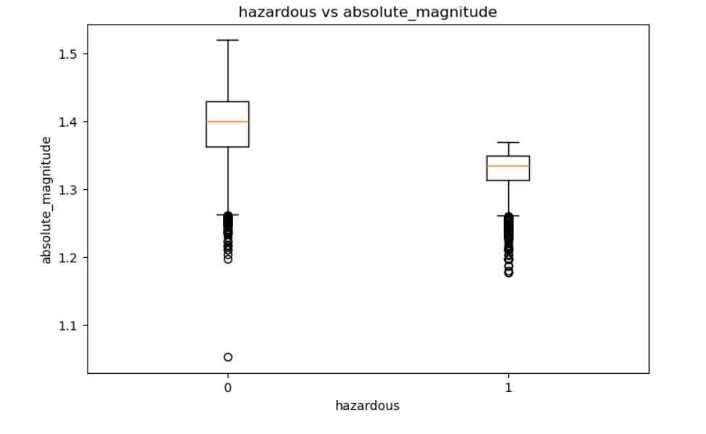
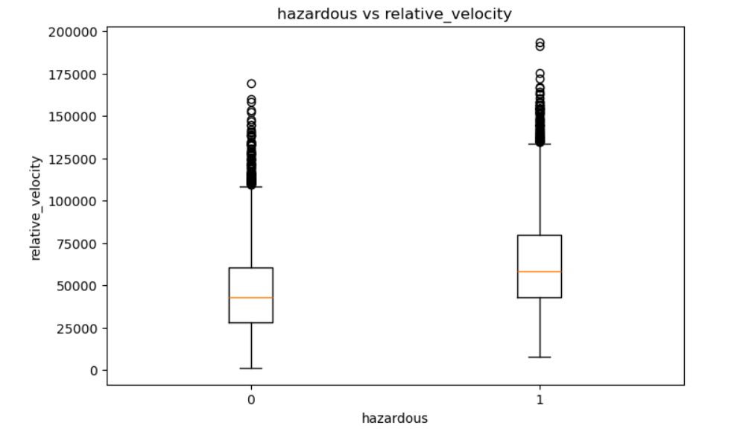
CPSC 322
Project #5
Near-Earth Objects Data Analysis
Danni Du, Lida Chen
Introduction
Classification Results
Web App
Near-Earth Objects (NEOs) are celestial bodies that have orbits bringing them close to Earth. The primary objective of this project is to analyze NEO data and build machine learning classifiers to predict whether an asteroid is hazardous based on its physical and orbital characteristics like the estimated size, velocity, distance, and magnitude of asteroids.
Text & screenshots here
EDA
The dataset contains 10,000 instances with five key features, and we choose 'hazardous’ as the target label.
Conclusion
One key challenge in classifying the dataset is the inherent imbalance between hazardous and non-hazardous objects, which can lead to biased predictions in certain classifiers.
To improve classification, incorporating more complex models such as Support Vector Machines or Neural Networks could enhance performance, especially for identifying complex relationships in the data.
Github Link:
https://github.com/moyigu/CPSC322-Final-Project.git
The K-Nearest Neighbors (KNN) is the best classifier in identifying hazardous asteroids. Both the Decision Tree and the Random Forest showed stable results with an F1 score of 0.78. The Naive Bayes classifier also got 0.78, but sometimes it could reach to 0.84 in some training round. KNN performed so well mainly because it is designed for numerical values. Our other classifiers are basically designed for categorical values. This means they may ignore some difference between instances, because we classified some different values into same group(level), and their differences are eliminated. However, KNN can directly know which train instances are closest to the unseen instance.
NASA Open API
NEO Earth Close Approaches
--From Kaggle https://www.google.com/url?q=https%3A%2F%2Fwww.kaggle.com%2Fdatasets%2Fsameepvani%2Fnasa-nearest-earth-objects

